Slide 1
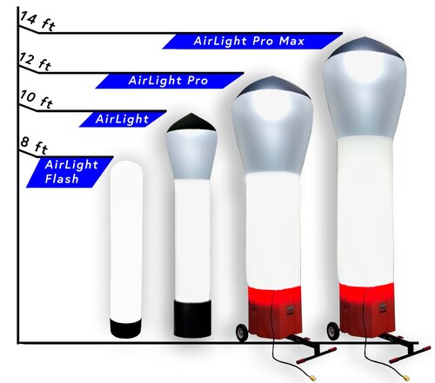
Airlight series
The worlds most portable light tower

Slide 3
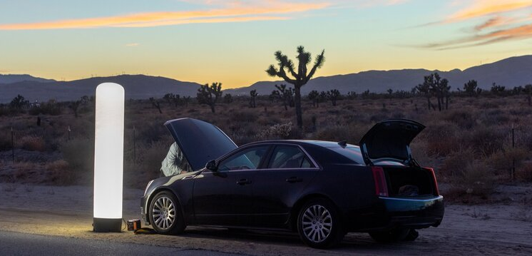
Airlight FLASH
Height: 8’ Tall
Weight: 17 Pounds
Wattage: 216 Watts
Voltage: 120V AC
Output: 18,000 Lumens
Area: 4000 Square Feet
Footprint: 18” x 18” x 9”

Slide 4
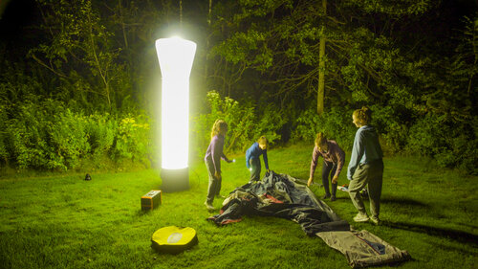
Airlight
Height: 9’-9” Tall
Weight: 29 Pounds
Wattage: 336 Watts
Voltage: 120V AC
Output: 37,200 Lumens
Area: 6000 Square Feet
Footprint: 20” x 20” x 18”

Slide 5
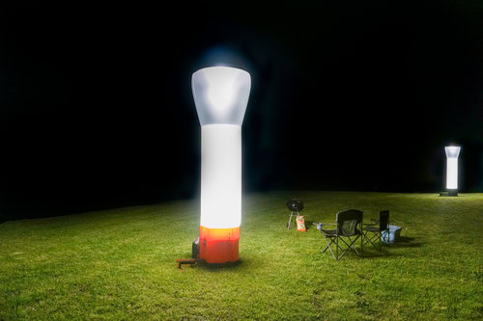
Airlight pro
Height: 12’ Tall
Weight: 64 Pounds
Wattage: 860 Watts
Voltage: 120V AC
Output: 74,400 Lumens
Area: 13,000 Square Feet
Footprint: 28” x 28” x 24”

Slide 6
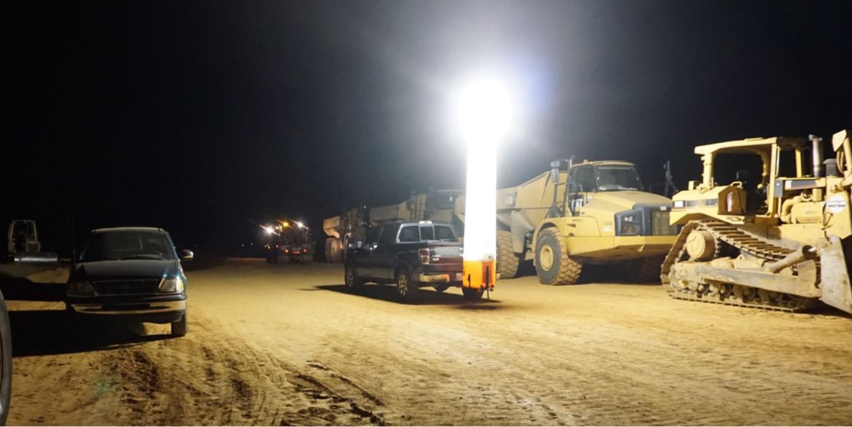
Airlight pro Max
Height: 14’ Tall
Weight: 72 Pounds
Wattage: 1,100 Watts
Voltage: 120V AC
Output: 111,000 Lumens
Area: 18,000 Square Feet
Footprint: 28” x 28” x 24”

Slide 7
